Slide 1
Using student researchers to get high-quality narrative accounts in L2 learning motivation research
Neil McClelland
University of Kitakyushu
neil.m4@gmail.com

Slide 2
Outline
Introduction:
Context of the study
Theoretical basis:
Mixing respondent and operant measures
Initial outcomes:
Qualitative (thematic analysis)
Quantitative (case comparisons)

Slide 3
Introduction
Context of the study
Mid-sized public university (West Japan)
Global Human Resources Program (B type)
Objectives
Non-experimental - descriptive research
Non-mathematical explanation (individual differences)
Listening to the voice of the students
Methodology
Quantitative vs Qualitative distinction
Mixing respondent and operant research methods

Slide 4
Research Method
Student Researchers
Peer-group interviews in first language
Facilitate inhibition-free interactions
Level playing field (language)
Mixed Methods Protocol
Combined respondent and operant measures:
Standardized questionnaire (Quantitative)
Critical-incidents elicitation methods (Qualitative)

Slide 5
Respondent vs Operant Measures
McClelland (1980)
Respondent measures
Question/response formats (agenda set by researcher through survey items or interview questions)
Self-attributed motives (conscious self-evaluations)
Operant measures
Elicitation procedures that allow participants to speak on any topic
(e.g. picture description or narrative methods)
Implicit motives (subconscious)

Slide 6

Rorschach test
Rorschach (1921)

Slide 7
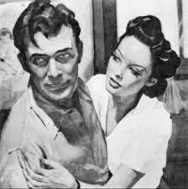
Thematic Apperception Test - TAT
Morgan and Murray (1935)

Slide 8
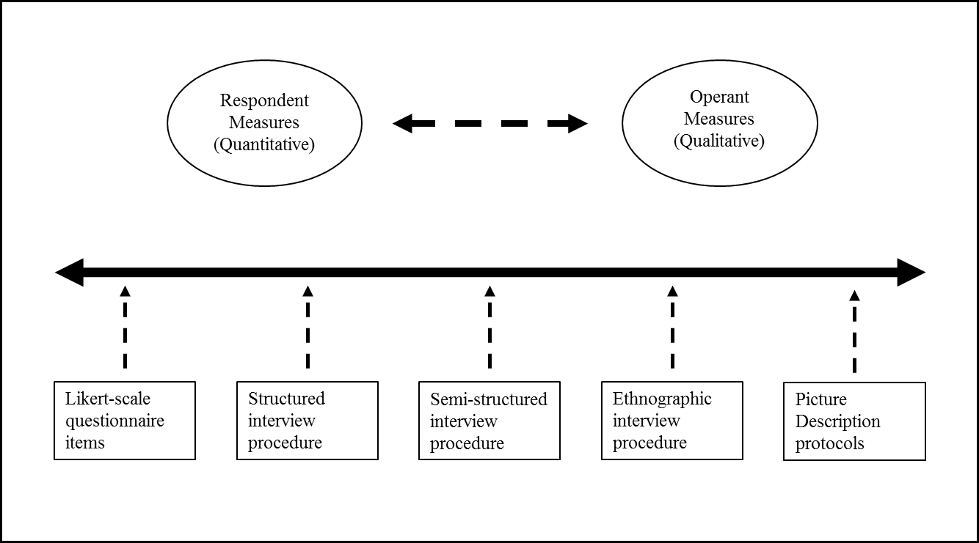
A Continuum of Approaches

Slide 9
The Current Study
Combining Respondent and Operant Measures into a Mixed-methods protocol
Mini-questionnaire
Standardized L2 motivation questionnaire (Likert scales)
Semi-structured interview with Q & A
Wheel of fortune – guided critical incident accounts
Narratives from self-generated picture cues
Tree of memories – freestyle narratives

Slide 10
(1) Mini-questionnaire
Three motivational dimensions
  Friendly Internationalism
  Societal Pressure
  Instrumentals
  I want to make friends with foreigners through English
  English is important to me because it will help me participate more easily in the activities of other cultures
  English is important to me because I am interested in foreign travel

Slide 11
Scores standardized against results from the full cohort of students in the Dept. of Foreign Studies (N=192)
Quantitative Results

Slide 12
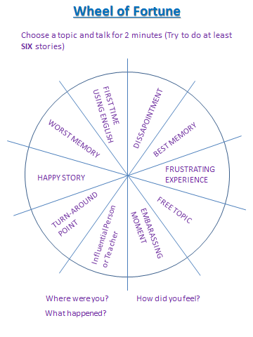
2) Semi-structured interview (Q & A)

Slide 13
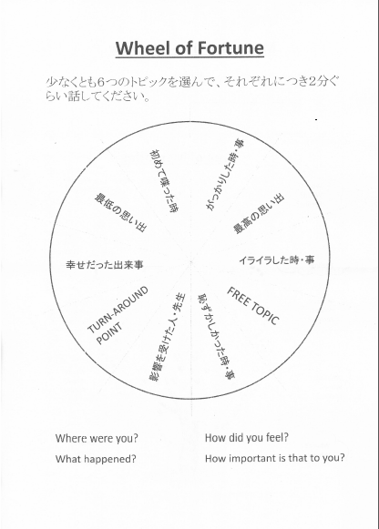

Slide 14
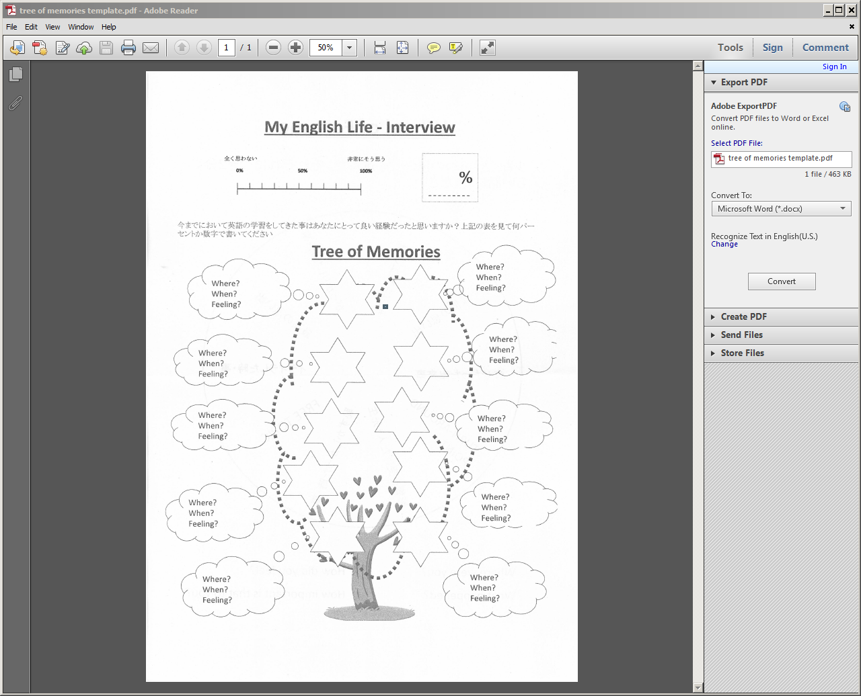
3) Narratives from self-drawn pictures

Slide 15
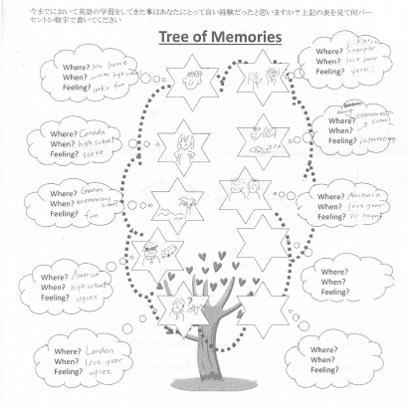

Slide 16
Results - Thematic Analysis
Procedure
Transcription
Analysis of word use
Thematic analysis – emergent themes (Nvivo 10)
Correlation of most common themes with scores on questionnaire dimensions

Slide 17
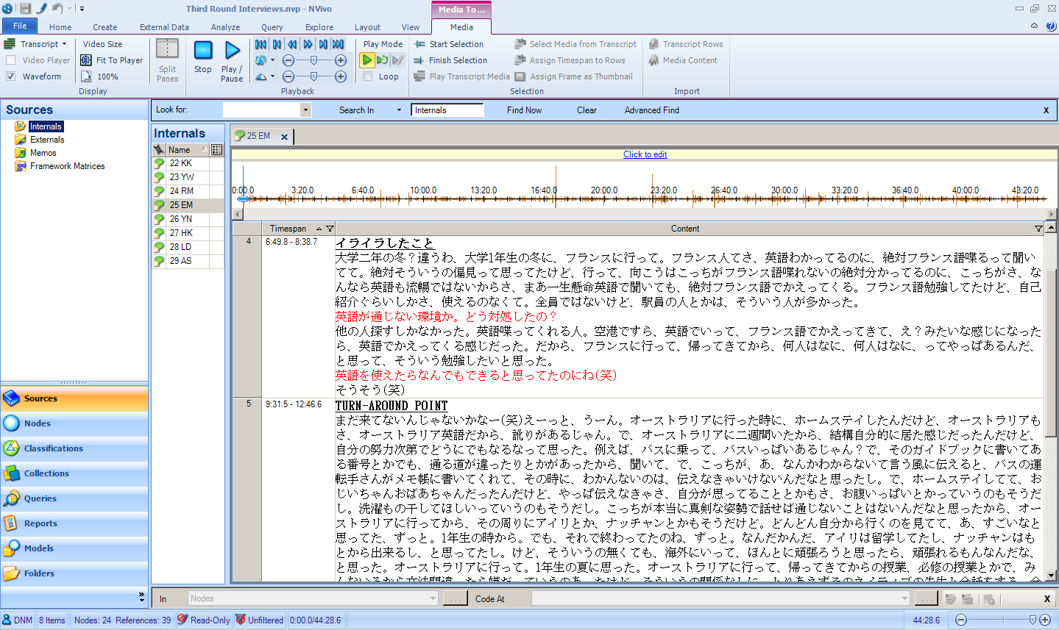

Slide 18






Slide 19
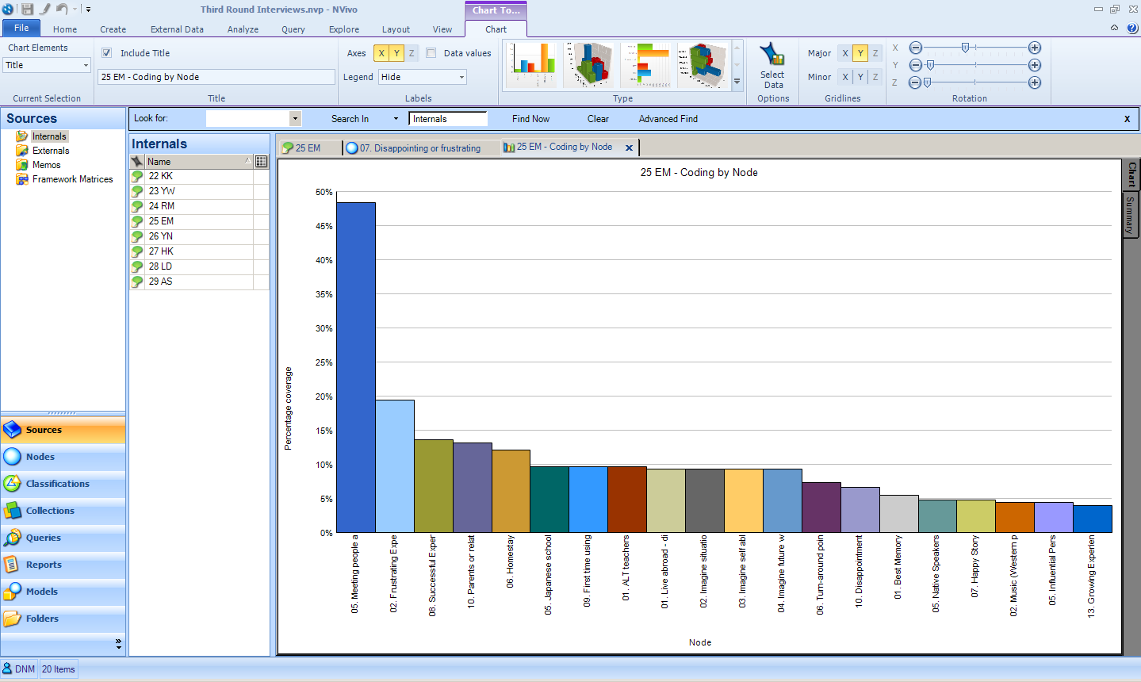

Slide 20
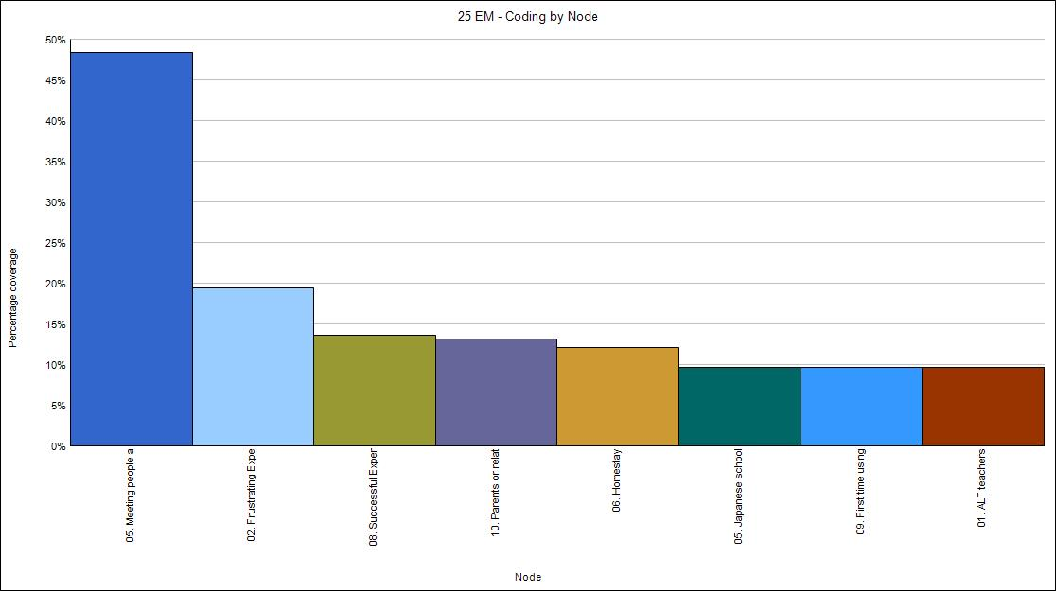

25 EM
Meeting People abroad 48%
Frustrating Experience 19%
Successful Experience 14%
Parents or Relatives 13%
Homestay 12%
School teachers 10%

Slide 21
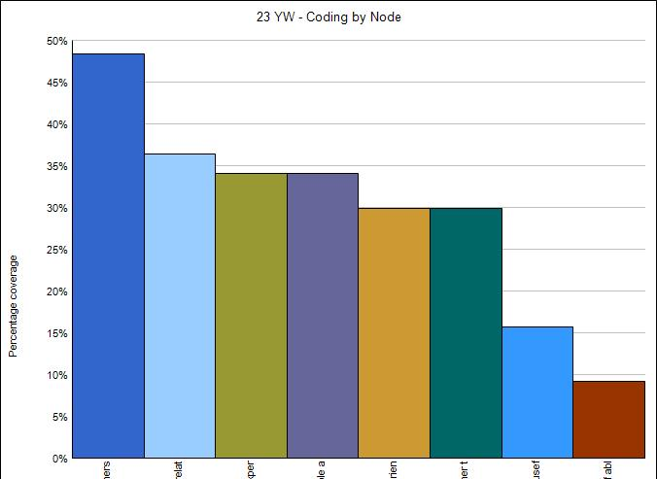

23 YW
Experiences with foreigners outside school 48%
Parents or Relatives 36%
Successful Experiences 34%
Meeting people abroad 34%
Growing Experience 30%
TOEIC or other tests 30%

Slide 22
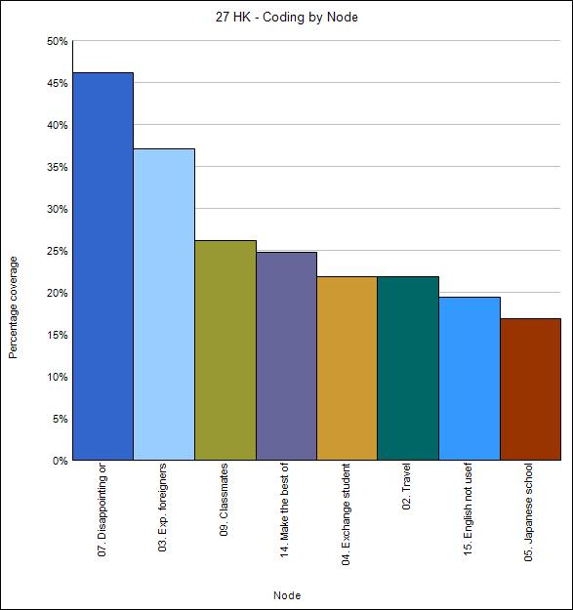

27 HK
Disappointing or Frustrating Experiences 46%
Experiences with foreigners outside school 37%
Classmates 26%
Make the best of things 24%
Exchange students 22%
Travel 22%

Slide 23
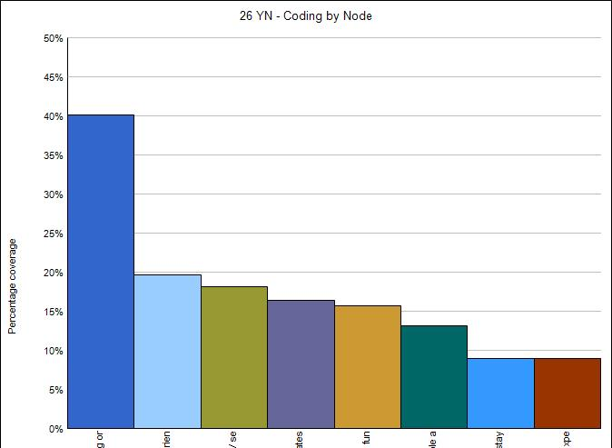

26 YN
Disappointing or Frustrating Experience 40%
Growing Experience 19%
Movies and TV series 18%
Classmates 16%
English is fun 15%
Meeting people abroad 13%

Slide 24
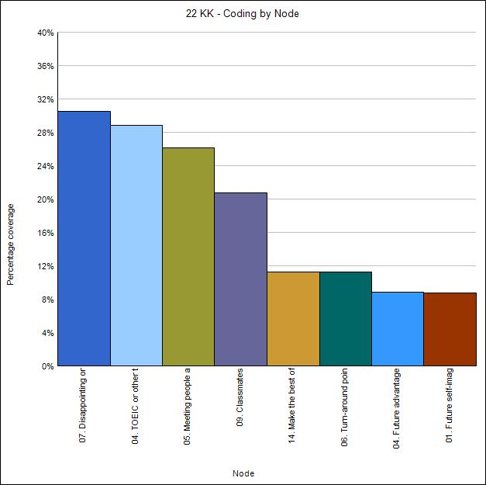

22 KK
Disappointing or Frustrating Experience 30%
TOEIC or other tests 29%
Meeting people abroad 26%
Classmates 21%
Make the best of things 12%
Future Advantage 8.8%

Slide 25
Summary

Slide 26
Initial findings
Little difference in the types of words used
English is perceived in very context specific terms
Importance of the quality of early experiences
Importance of real experiences rather than imagined goals
The significance of virtuous and vicious cycles
Impact of specific turn-around experiences
Individuals able to break out of vicious cycles as the result of critical incidents

Slide 27
Evaluation
Verdict on Operant Measures:
Rich narrative accounts puts the person back into individual differences (ID) research
The data speaks for itself in ways not predicted by existing L2 motivation theory
Room for improvement

Slide 28
The end
Do you have any comments or questions?
Contact: neil.m4@gmail.com

